Slide 1
HemTools Tutorial
4-18-2019
Yichao Li
Yichao.Li@stjude.org
https://hemtools.readthedocs.io

Slide 2
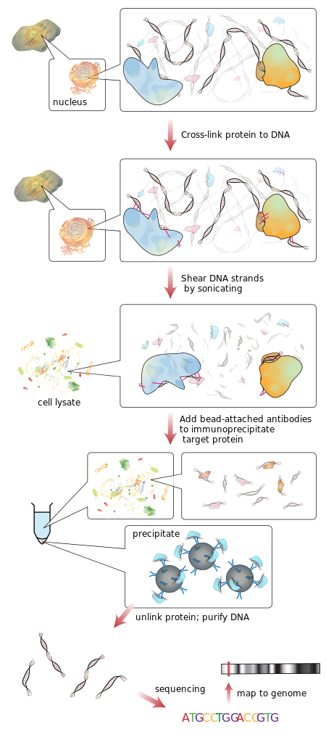
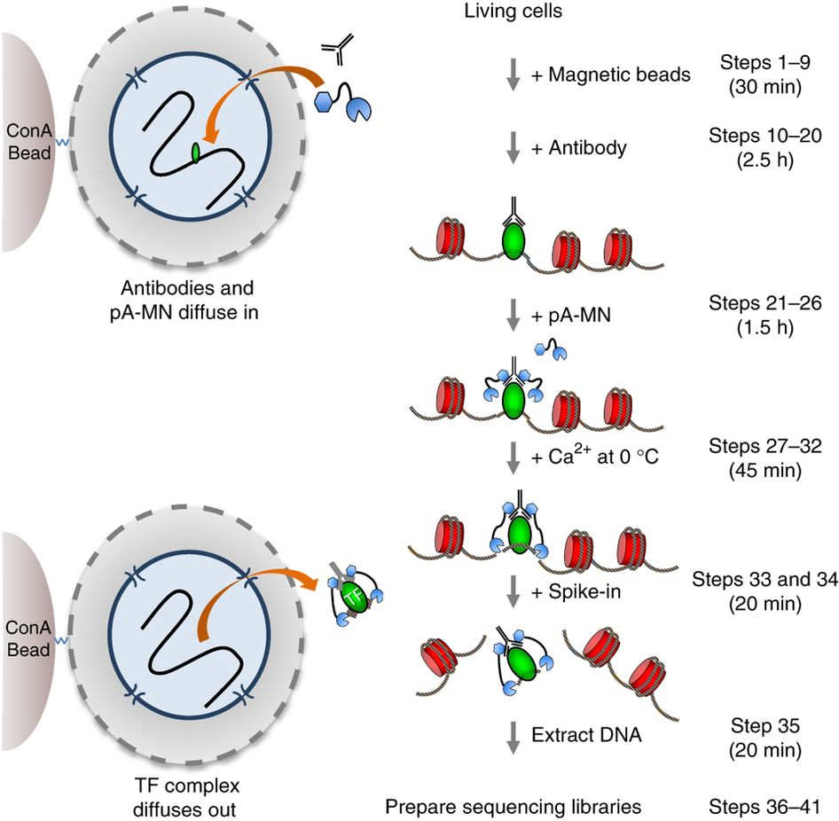
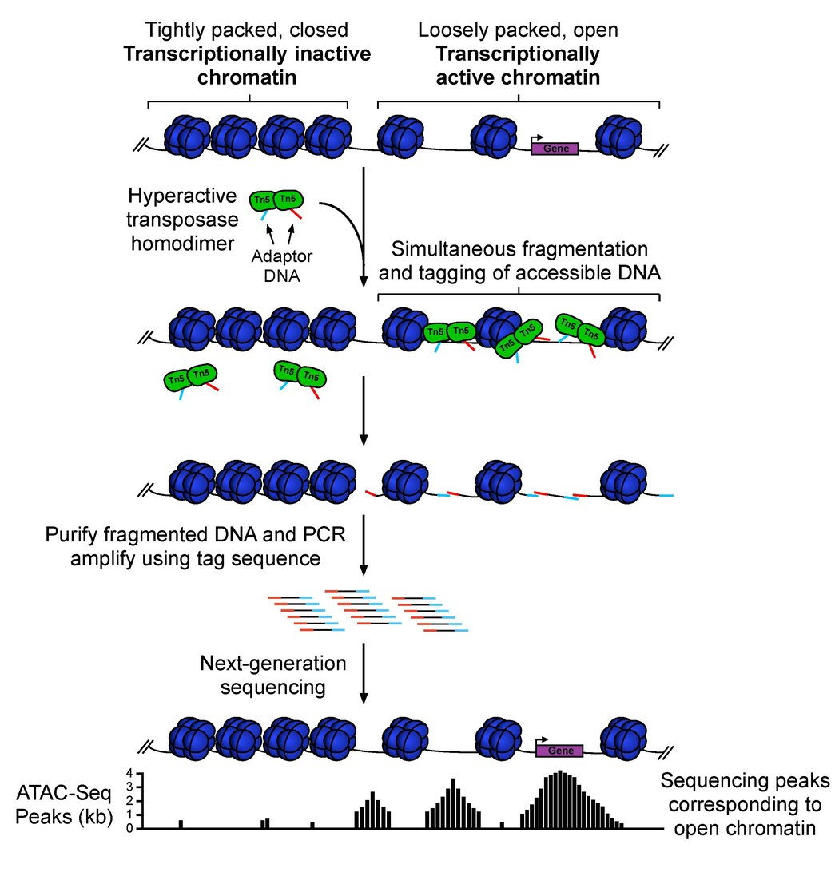
Outline
CUT & RUN
ChIP-seq
Software overview
Examples
ATAC-seq
ChIP-seq
CUT & RUN
General principles
Other functionalities
RNA-seq
CRISPR screening
Volcano plot
Questionnaire
ATAC-seq
https://hemtools.readthedocs.io

Slide 3
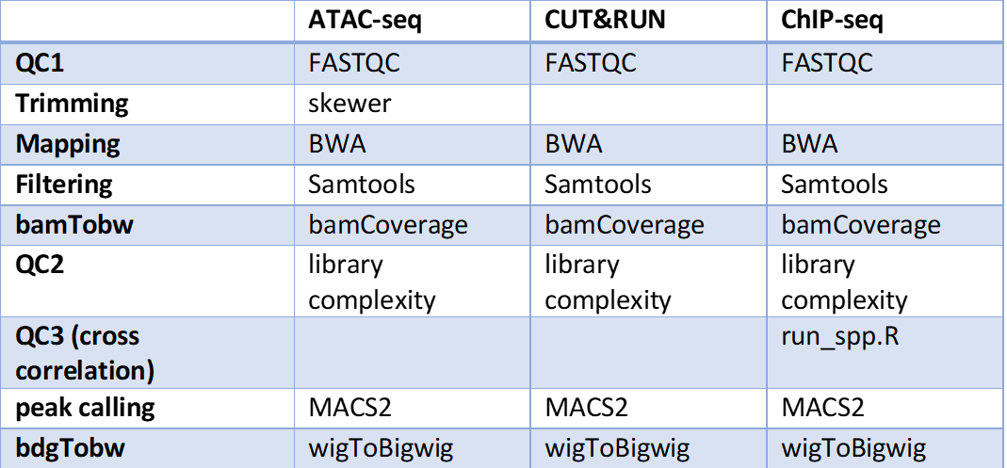
Software overview
Minimizing computation time

Slide 4
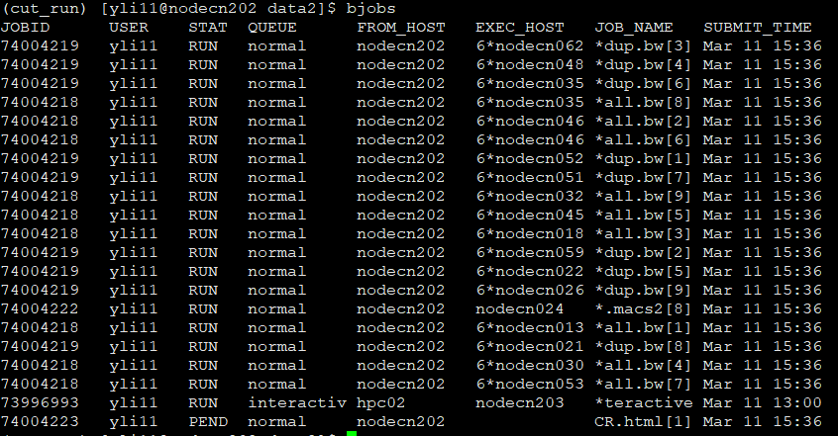
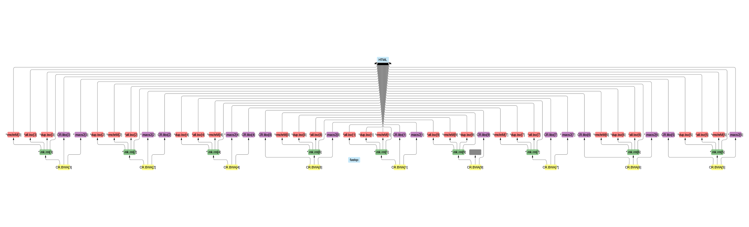
Software overview
Minimizing computation time
A tree of jobs

Slide 5
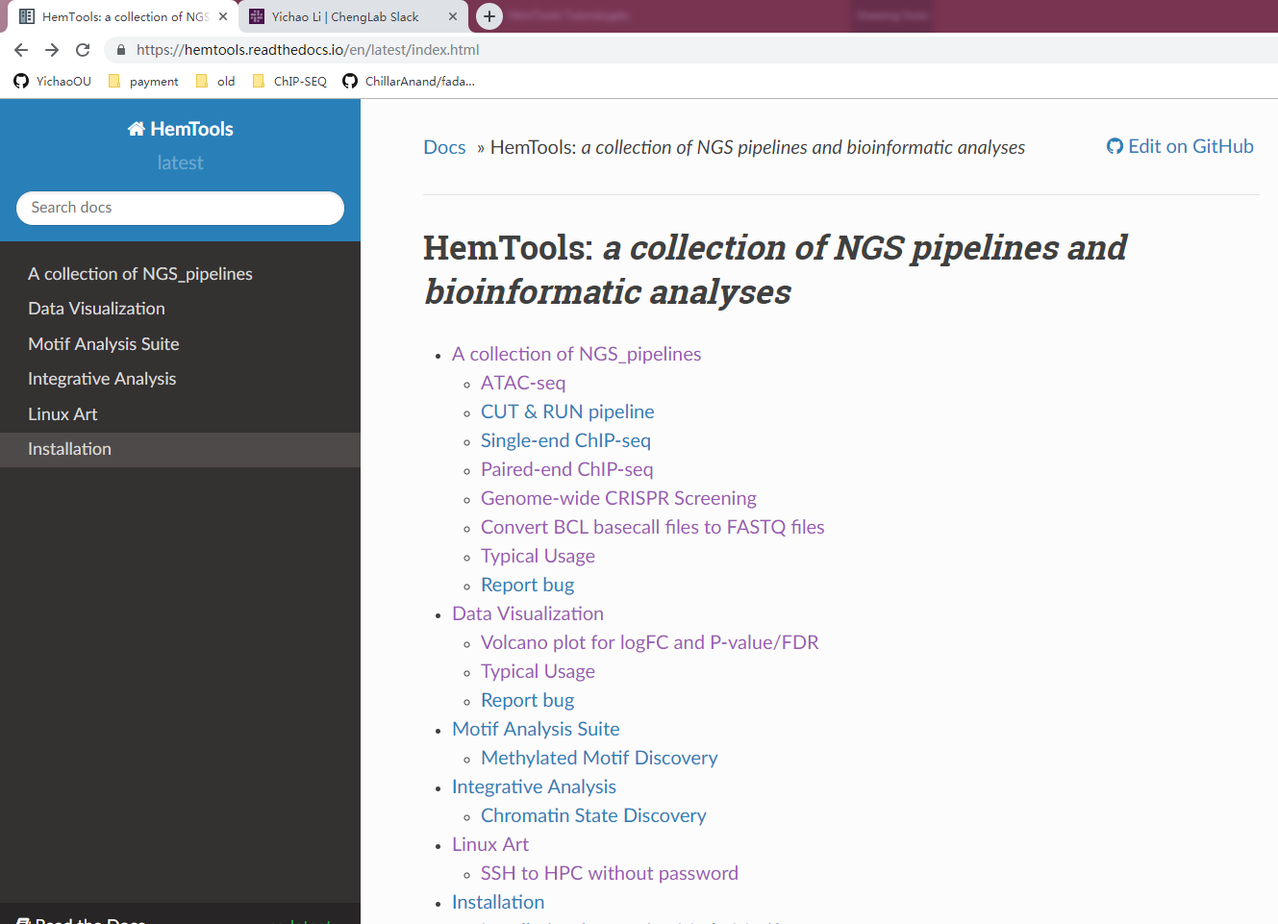
Software overview
Minimizing computation time
A tree of sub-jobs
Creating user-friendly interface
Online documentation
https://hemtools.readthedocs.io

Slide 6
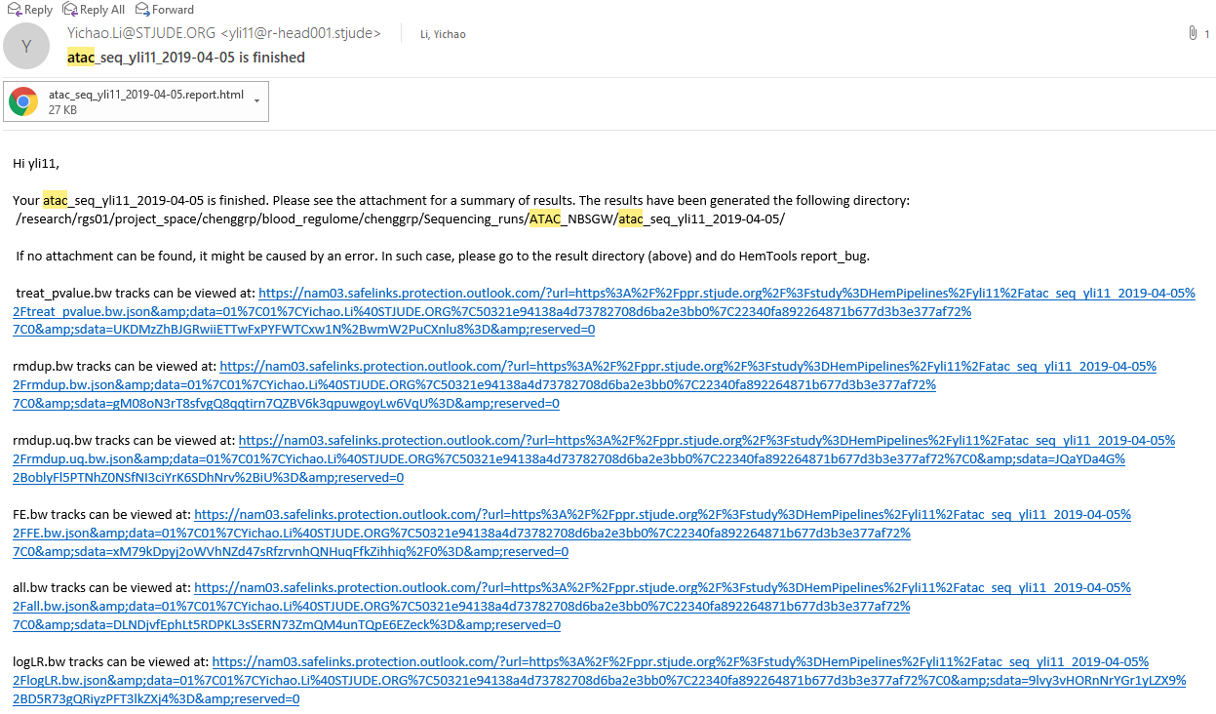
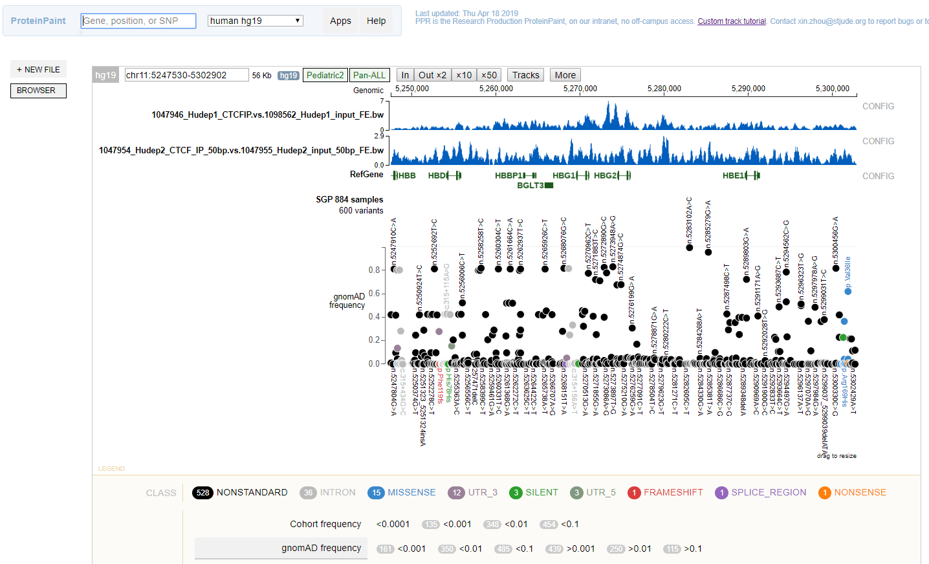
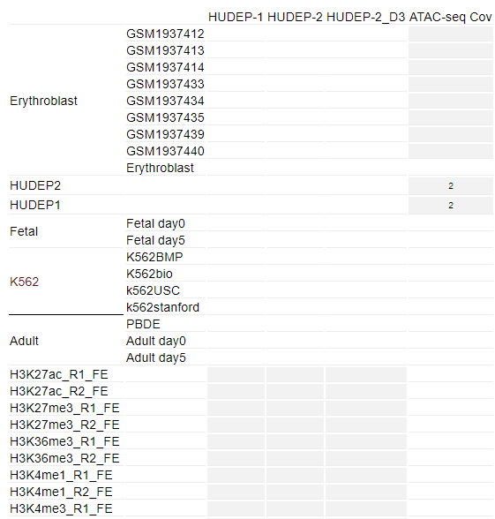
Software overview
Minimizing computation time
A tree of sub-jobs
Creating user-friendly interface
Online documentation
https://hemtools.readthedocs.io
Email notification system

Slide 7
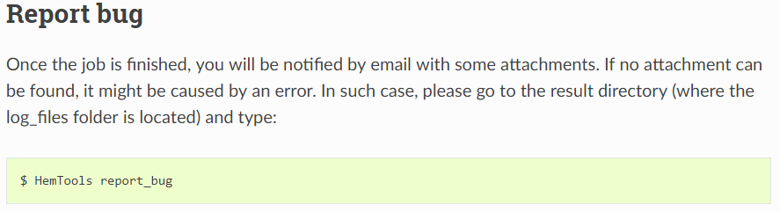
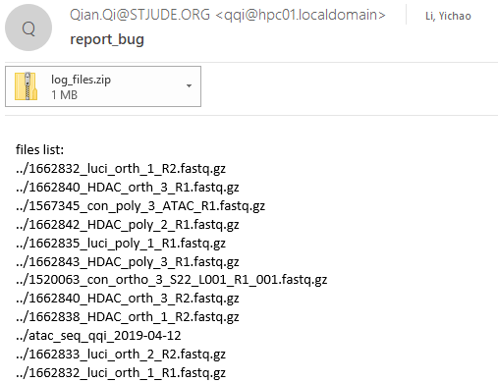
Software overview
Minimizing computation time
A tree of sub-jobs
Creating user-friendly interface
Online documentation
https://hemtools.readthedocs.io
Email notification system
Bug/Error reporting system

Slide 8
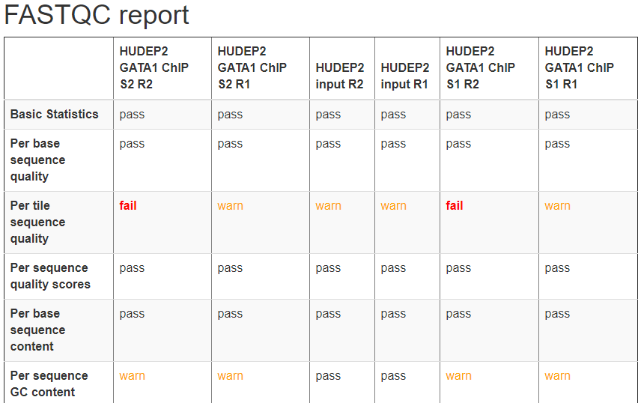
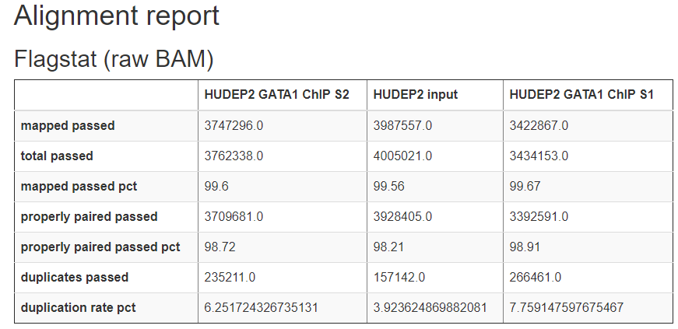
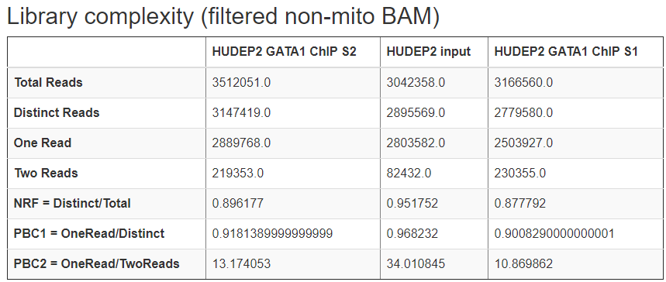
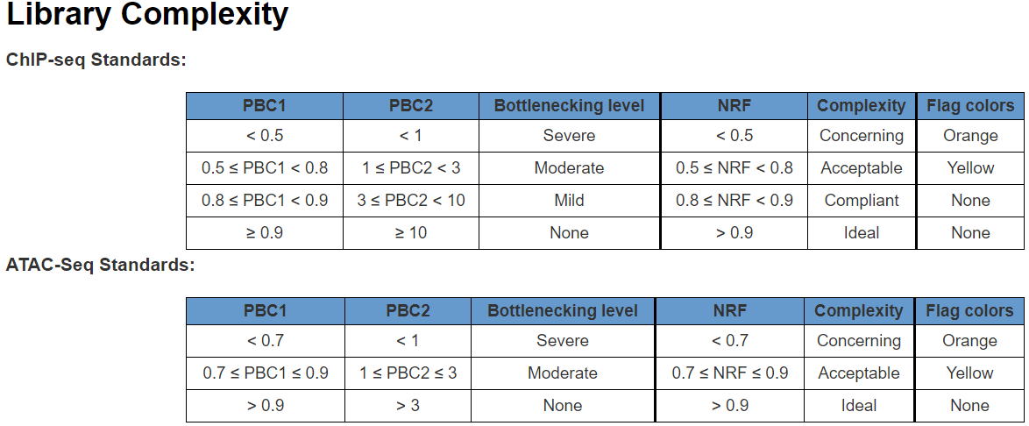
Software overview
Minimizing computation time
A tree of sub-jobs
Creating user-friendly interface
Online documentation
https://hemtools.readthedocs.io
Email notification system
Bug/Error reporting system
Visually-appealing reports
https://www.encodeproject.org/data-standards/terms/#library

Slide 9
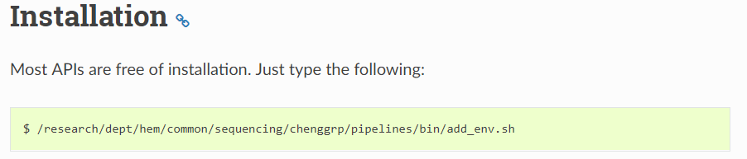
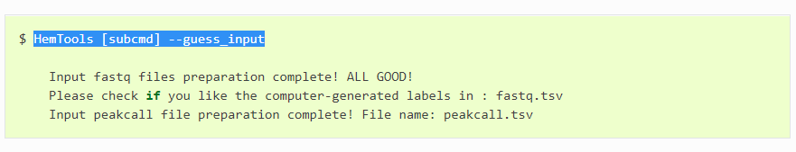
Software overview
Minimizing computation time
A tree of sub-jobs
Creating user-friendly interface
Online documentation
https://hemtools.readthedocs.io
Email notification system
Bug/Error notification system
Visually-appealing reports
Reducing user’s mental effort
Free of installation
Simple input files preparation

Slide 10
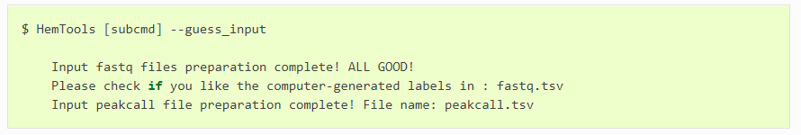
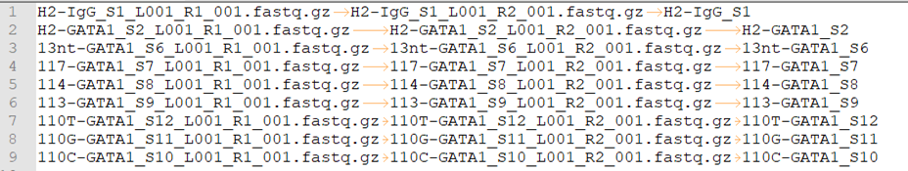
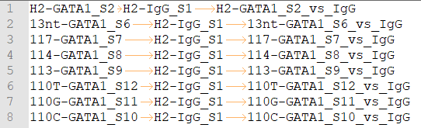
General principles: workflow
Load Python
Prepare Inputs
Run HemTools
-f, --input
-d, --design_matrix

Slide 11
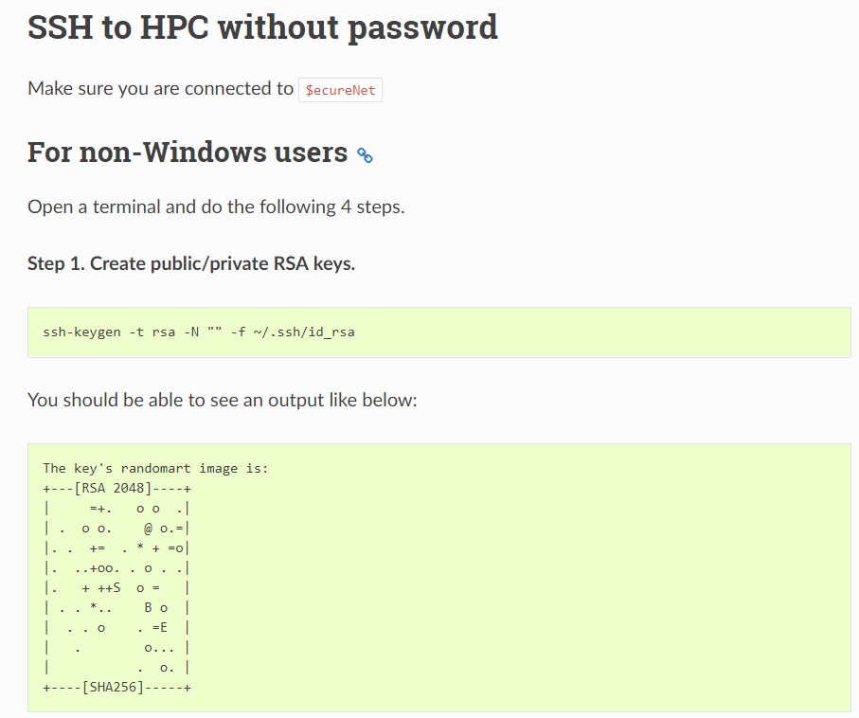
Hands on exercises
https://hemtools.readthedocs.io/en/latest/content/NGS_pipelines/tutorial.html

Slide 12
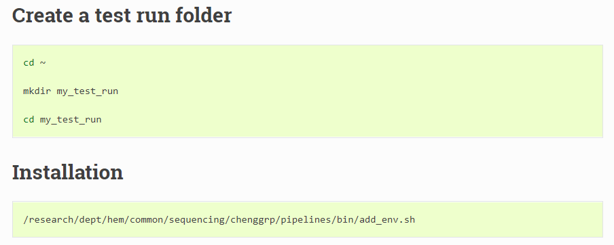
Hands on exercises
https://hemtools.readthedocs.io/en/latest/content/NGS_pipelines/tutorial.html

Slide 13
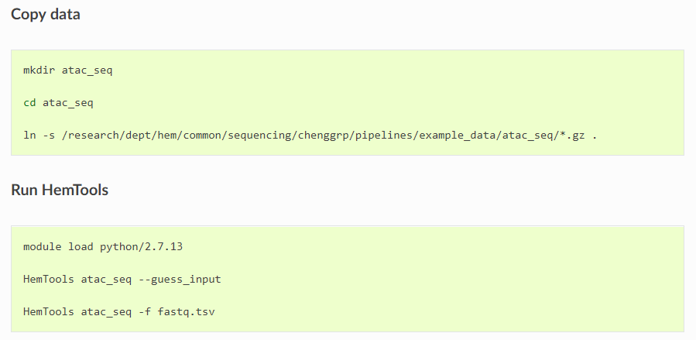
ATAC-seq example
Load Python
Prepare Inputs
Run HemTools
https://hemtools.readthedocs.io/en/latest/content/NGS_pipelines/tutorial.html

Slide 14
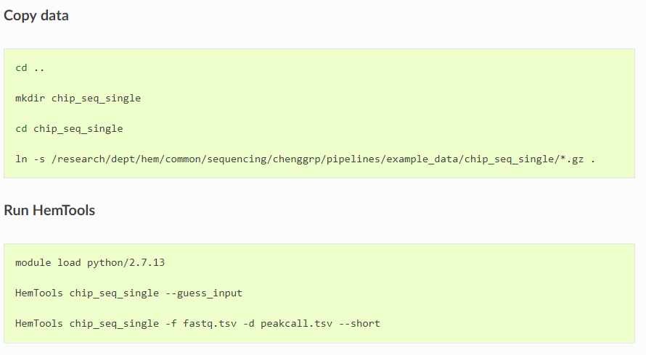
Single-end ChIP-seq example
Load Python
Prepare Inputs
Run HemTools
https://hemtools.readthedocs.io/en/latest/content/NGS_pipelines/tutorial.html

Slide 15
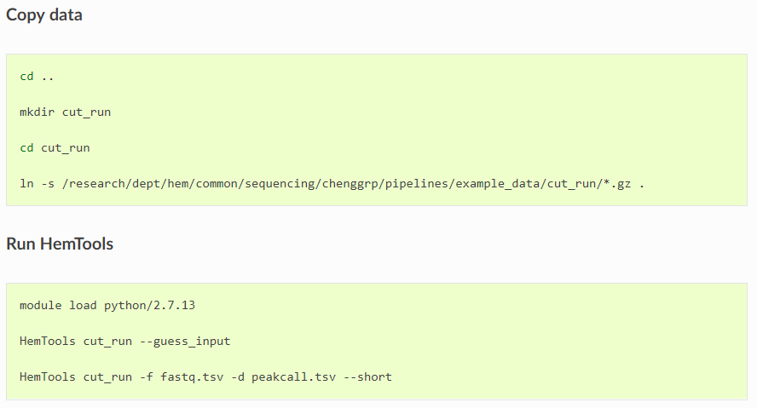
CUT & RUN example
Load Python
Prepare Inputs
Run HemTools
https://hemtools.readthedocs.io/en/latest/content/NGS_pipelines/tutorial.html

Slide 16
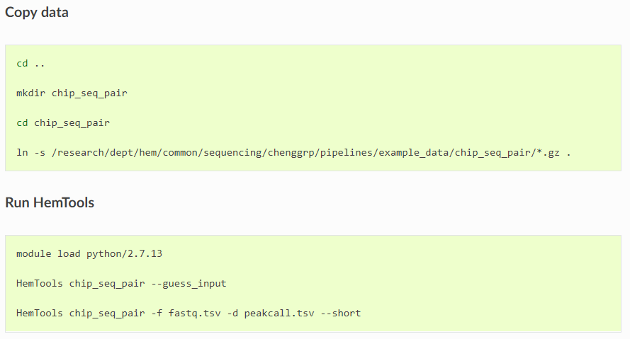
Paired-end ChIP-seq example
Load Python
Prepare Inputs
Run HemTools
https://hemtools.readthedocs.io/en/latest/content/NGS_pipelines/tutorial.html

Slide 17
General principles
Command format
HemTools subcmd some_required_parameters
HemTools atac_seq -f fastq.tsv
HemTools cut_run -f fastq.tsv -d peakcall.tsv
HemTools chip_seq_single -f fastq.tsv -d peakcall.tsv
HemTools chip_seq_pair -f fastq.tsv -d peakcall.tsv
subcmd is case-sensitive

Slide 18
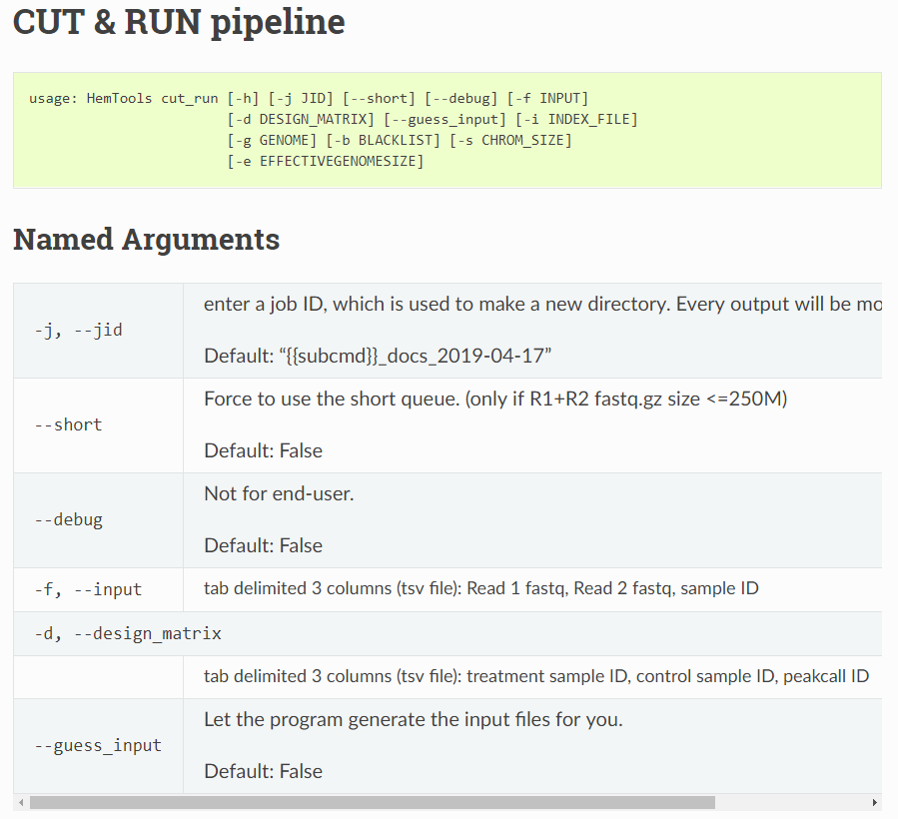
General principles
Required parameters
HemTools atac_seq -f fastq.tsv
HemTools cut_run -f fastq.tsv -d peakcall.tsv
HemTools chip_seq_single -f fastq.tsv -d peakcall.tsv
HemTools chip_seq_pair -f fastq.tsv -d peakcall.tsv

Slide 19
General principles
Command format
HemTools atac_seq -f fastq.tsv
HemTools cut_run -f fastq.tsv -d peakcall.tsv
HemTools chip_seq_single -f fastq.tsv -d peakcall.tsv
HemTools chip_seq_pair -f fastq.tsv -d peakcall.tsv
Input format (tsv, tab-separated values)
-f, --input
-d, --design_matrix

Slide 20
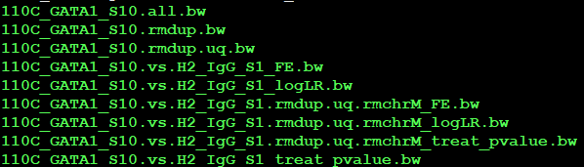
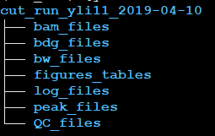
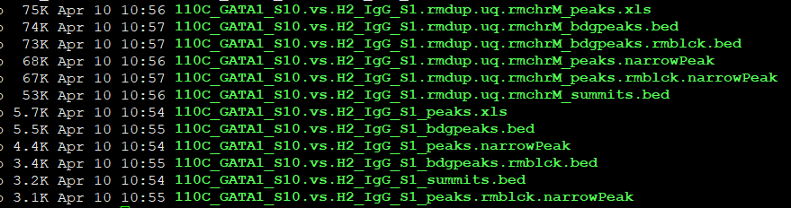
General principles
Output format
Paired-end data will run MACS2 twice:
rmdup.uq bam
raw bam
Single-end data will just run MACS2 using raw bam

Slide 21
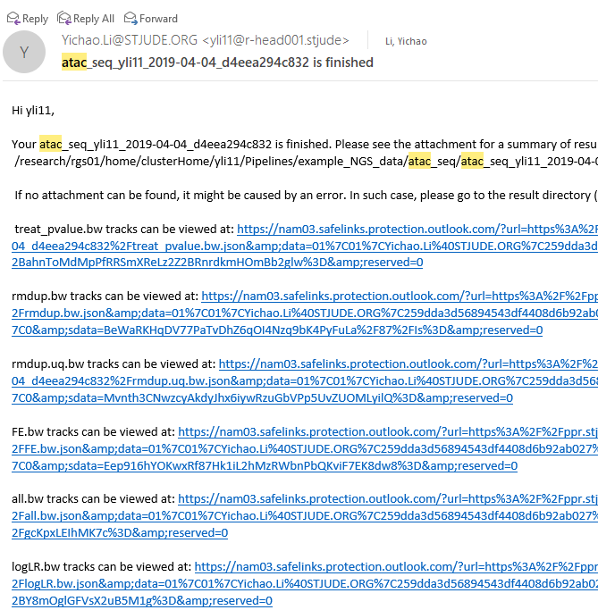
General principles
Report bugs
If no attachment can be found, it might be caused by an error. In such case, please go to the result directory (above) and do HemTools report_bug.
No Attachments!

Slide 22
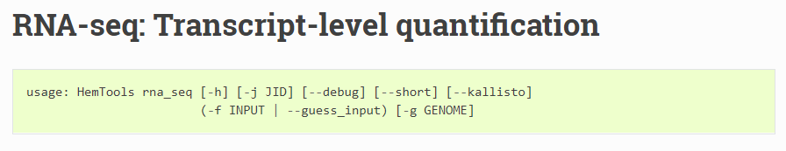
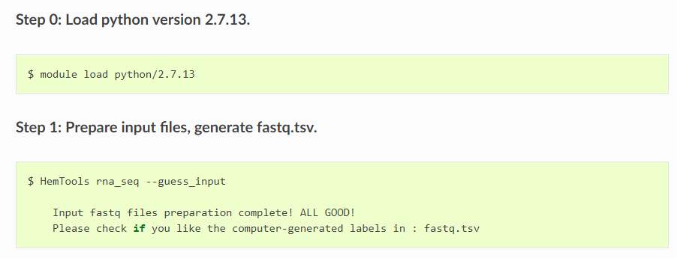
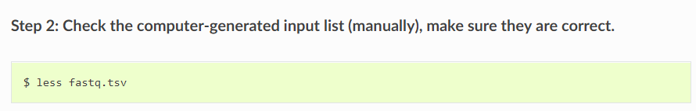
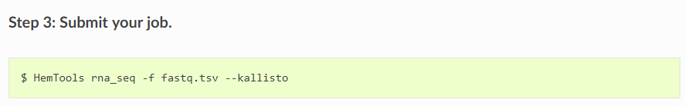
Other functionalities

Slide 23
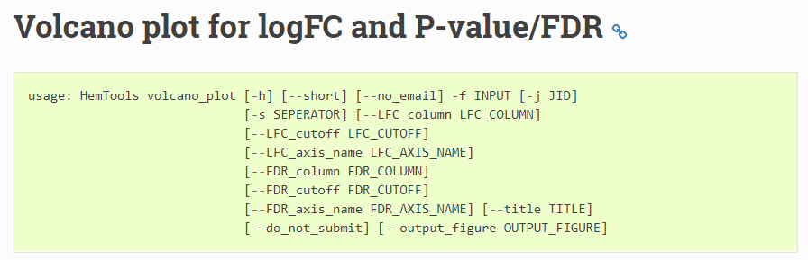
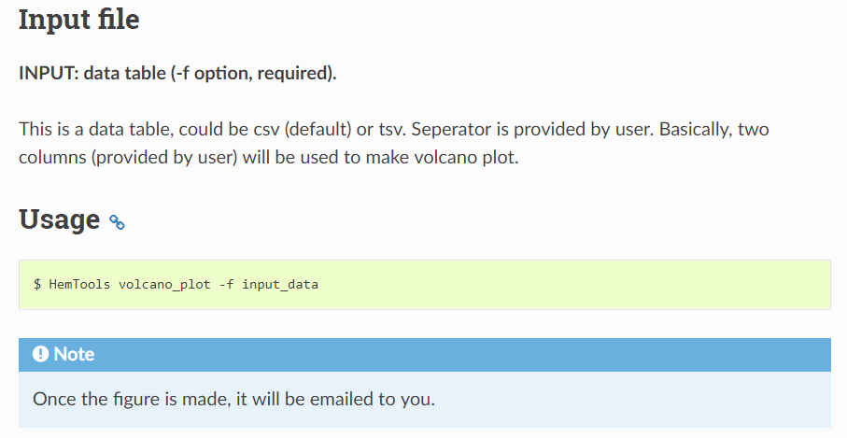
Other functionalities

Slide 24
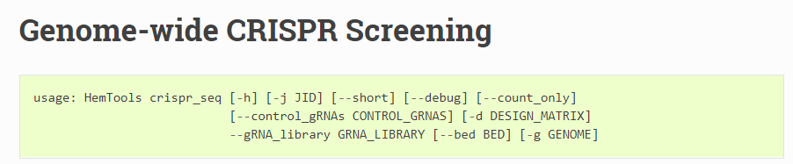
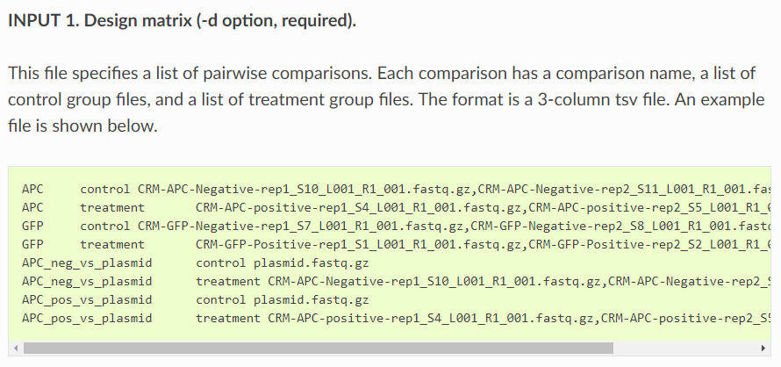
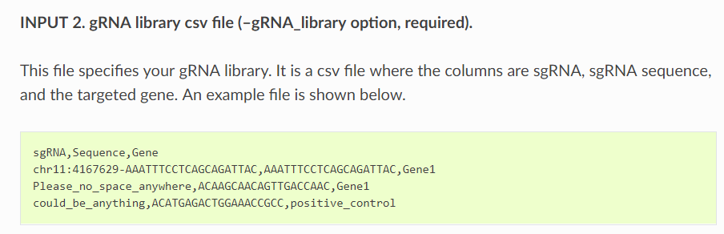
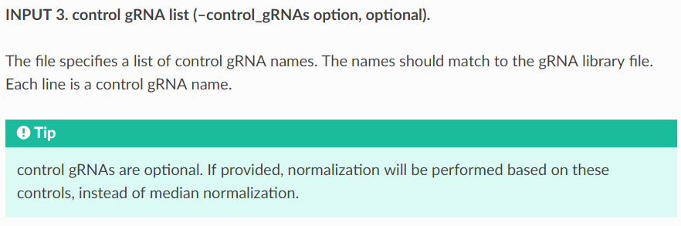
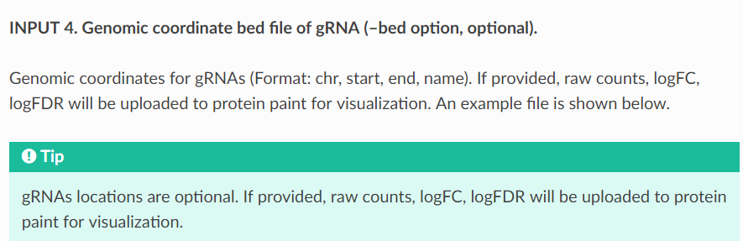
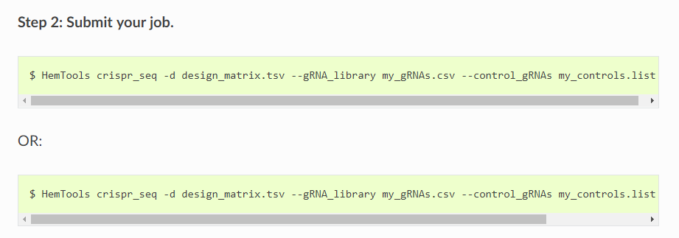
Other functionalities

Slide 25
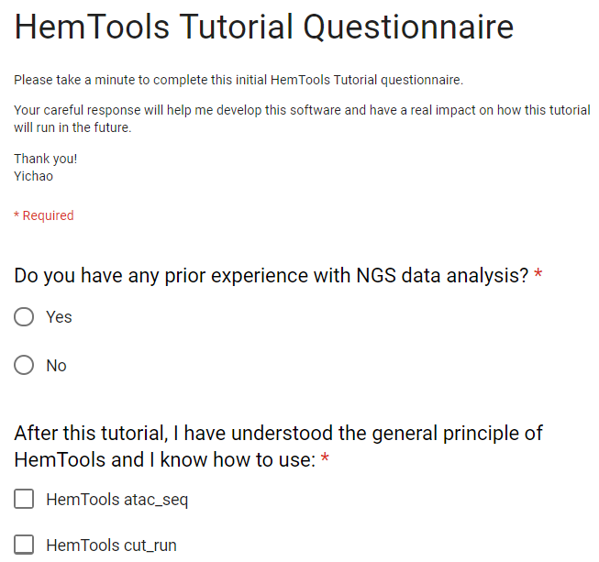

Questionnaire
https://hemtools.readthedocs.io/en/latest/content/NGS_pipelines/tutorial.html#id4

